Slide 1
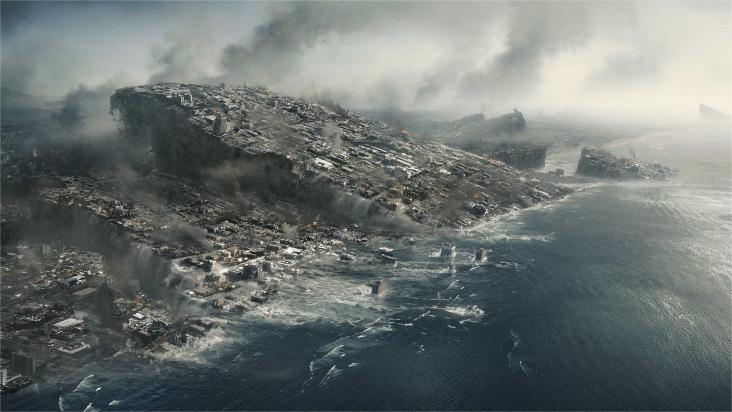
2012
The science behind the madness.
(The Movie)
By Cory C Mills

Slide 2
2012 in a Nutshell
Based of the popular “End of the World” myth
Global Disaster explained by plate tectonics
Story Line
  US Government learns of the coming dooms day
  Cover up
  Secretly sells safety tickets
  Preserves key cultural artifacts (racist)
  The world ends
  Return to Africa

Slide 3

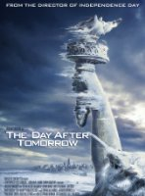
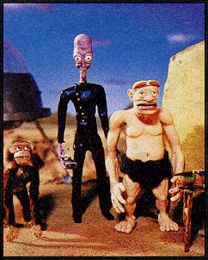
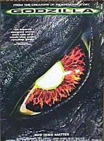

Director Roland Emmerich
Independence Day (1996)
Godzilla (1998)
Day After Tomorrow (2004)
The Zone (Filming)
Images courtesy of: IMDb.com and Viacom Inc

Slide 4
Scientific Themes in this Movie
Geology
  Hapgood’s Earth Crust Displacement Theory
Geophysics
  Running faults
Marine Physics
  Tsunamis crashing over the Himalayas
Astrophysics
  Mutated Neutrinos melting the Earth’s core

Slide 5

What is a Neutrino?
Subatomic particle
No charge
Almost no weight
Little gravitational influence
Free flowing
Super abundant
Emitted by atomic decay, fission and fusion

Slide 6
What they got right!
The sun does emit neutrinos
Increased solar activity leads to increased neutrino output
They do use underground laboratories to study neutrinos
Neutrinos have the ability to travel through the Earth’s crust
  To and through the core

Slide 7
What they got wrong…
Neutrinos cannot mutate
Neutrinos do not effect matter significantly
Neutrinos are matter, not energy
Nothing can melt the Earth’s core while leaving the crust unaffected

Slide 8
So why use Neutrinos
Little known of but they sound scientific
Still not well understood
People associate the 2012 myth with the Mayan celestial calendar
The movie required a reason and there is no conceivable reason

Slide 9
A word from out scientists
Neutrinos play a significant role in the universe
The world will not end in 2012 by any predictable or conceivable means
The Mayan calendar does not end on the 21st of December, 2012

Slide 10
“Just as the calendar you have on your kitchen wall does not cease to exist after December 31, the Mayan calendar does not cease to exist on December 21, 2012.”
(NASA.gov 2009)

Slide 11
Images
All Movie Photos. 2012 Phots. Colombia Picture. http://www.allmoviephoto.com/ photo/2009_2012_photo.html
Internet Movie Database. 2012. IMDb.com Inc. http://www.imdb.com/title/tt1190080/
Prometheus and Bob Tapes. Viacom Inc. http://home.grandecom.net/~tigger512/pnb/ProNBob.html

Slide 12
Bibliography
Anonymous. 2010. 2012. Retrieved October 9, 2010, from IMDB: http://www.imdb.com/title/tt1190080/
Casper, D. Undated. What's a neutrino? Retrieved 9 October 2010, from http://www.ps.uci.edu/~superk/neutrino.html
Dunbar, B. 2009. 2012: Beginning of the end or Why the world won't end? (J. Townsend, Editor). November 9. Retrieved 9 October 2010, from NASA.gov: http://www.nasa.gov/topics/earth/features/2012.html
Emmerich, R. (Director). 2009. 2012 [Motion Picture]. Colombia Pictures.

Slide 13

By Cory C Mills

